Slide 1
Resume Classification
ExceLR Project - Group 6

Slide 2
Group Members
LIVIN K GEORGE
AKHILESH LAXMAN
ABDUL DANISH
PUPPALA NITHIN
DEPURI VINAY
MEKALA LOHITH
ABINASH BEHARA

Slide 3
Objective
Develop a Resume Classification System that automatically categorizes resumes into relevant job domains such as Peoplesoft resumes, SQL Developer Lightning insight, workday resumes and React JS Developer.
The system leverages Natural Language Processing (NLP) and Machine Learning to analyze resume text, extract key skills, and match them to suitable job profiles.

Slide 4
Dataset Details
Source: Collected from ExceLR project team
Total samples: 79 resumes
Features: Resume text, Category (target)
Categories include: as Peoplesoft resumes, SQL Developer Lightning insight, workday resumes and React JS Developer.
Data cleaned, balanced, and preprocessed for text analysis.

Slide 5
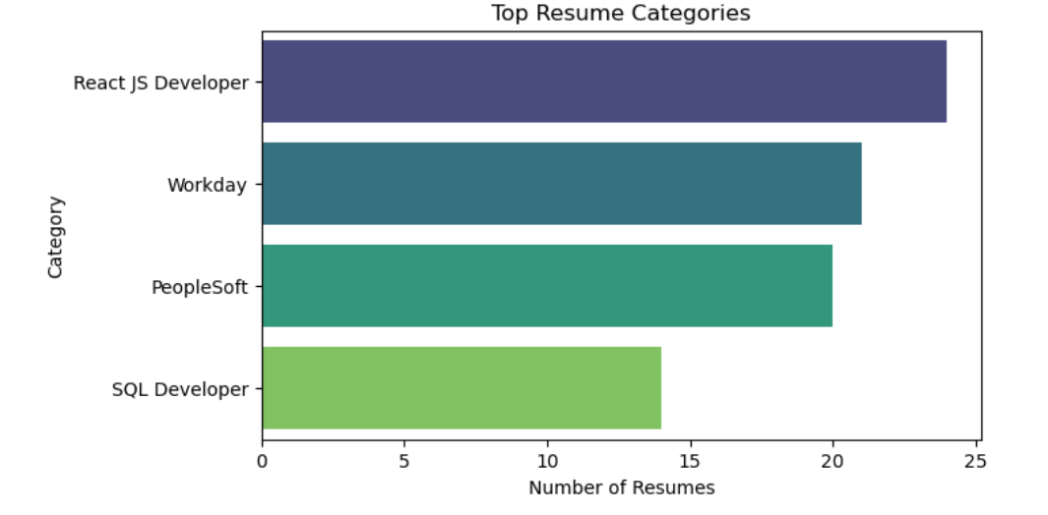
Top Resume Categories

Slide 6
Exploratory Data Analysis
Checked for missing values and distribution of resume categories.
Data heavily skewed towards as Peoplesoft resumes, SQL Developer Lightning insight, workday resumes and React JS Developer.
Word Cloud visualizations show dominant keywords for each domain.
Example: React Developer resume contain ‘React’, ‘Bootstrap’, ‘JavaScript’ and ‘JSON’

Slide 7
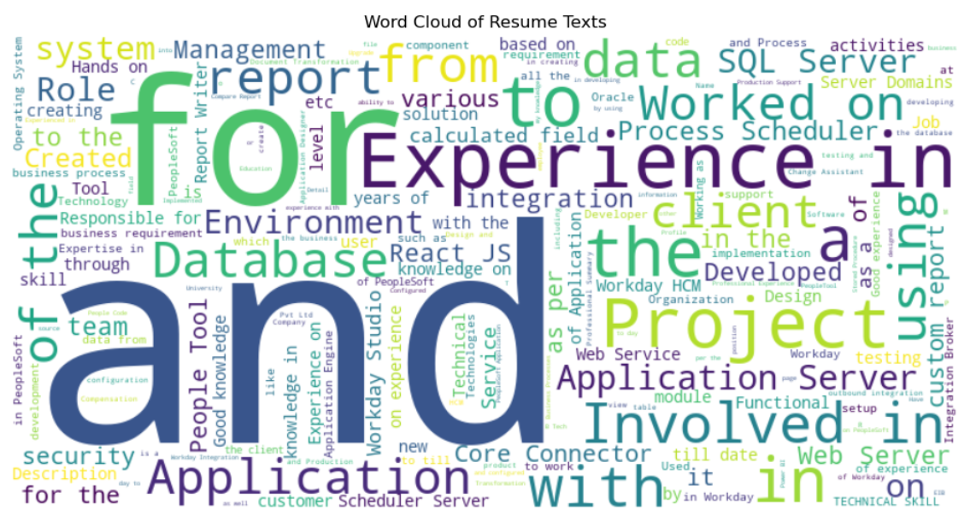
Word Cloud Of Resume Text

Slide 8
Text Preprocessing
Removed punctuation, special characters, and stopwords.
Tokenized resume text into words.
Applied lemmatization using spaCy/NLTK.
Converted text to lowercase.
Prepared cleaned text corpus for vectorization

Slide 9
Feature Extraction
Used TF-IDF Vectorizer to convert text into numerical features.
Limited vocabulary to top 200-300 most frequent words.
TF-IDF helps capture importance of terms relative to each resume.
Result: High-dimensional sparse feature matrix used for classification.

Slide 10
Model 1 – Naive Bayes Classifier
Algorithm: Multinomial Naive Bayes
Works well with high-dimensional text data.
Achieved accuracy: ~90%
Strength: Simple and fast baseline model.
Limitation: Assumes independence between words

Slide 11
Model 2 – Logistic Regression
Used as a linear baseline classifier.
Accuracy: ~92%
Strength: Interpretable coefficients, efficient for large datasets.
Limitation: May struggle with non-linear separability.

Slide 12
Model 3 – Support Vector Machine (SVM)
Kernel: Linear SVC (best performance)
Accuracy: ~94%
Strength: Handles high-dimensional sparse data efficiently.
Limitation: Training time increases with large datasets.

Slide 13
Model 4–Ensemble/Hybrid Model
Combined predictions from Logistic Regression, SVM, and Naive Bayes.
Accuracy: ~95%
Strength: More robust and generalized predictions.
Limitation: Increased computational complexity.

Slide 14
Model 5 – Random Forest
Estimators: 100 (default)
Accuracy: ~96%
Strength: Handles non-linear relationships well and reduces overfitting using ensemble of decision trees
Limitation: Can be slower to predict for very large datasets and less interpretable than single decision trees.

Slide 15
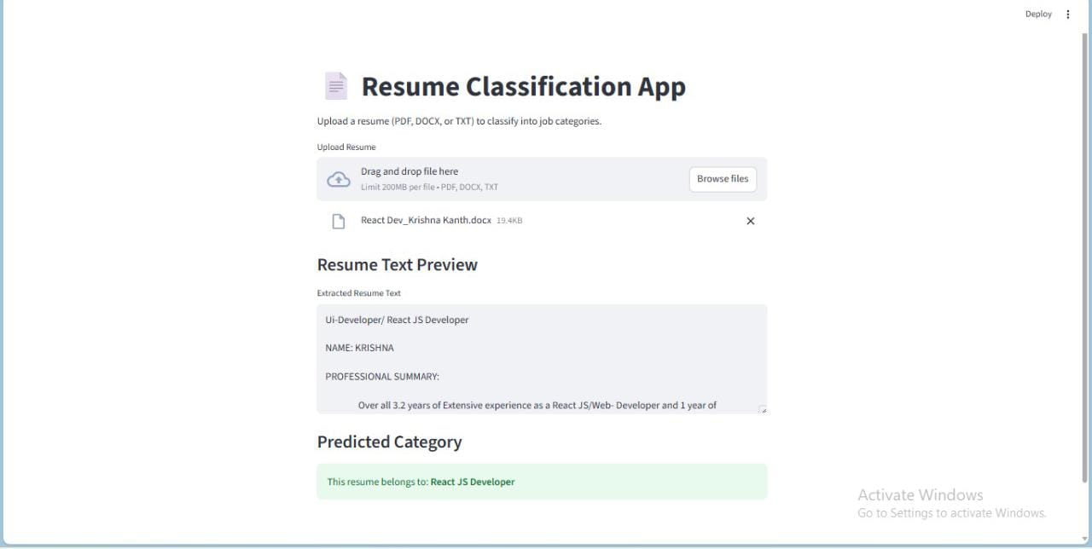
Deployment

Slide 16
Final Model Evaluation Summary
Compared models: Naive Bayes, Logistic Regression, SVM, Decision Tree, and Random Forest.
Models were tested based on Accuracy, Precision, Recall, and F1-score.
Random Forest gave the best accuracy (around 95–96%).
Random Forest was chosen as the final model because it gave highest accuracy, handled complex data well, and produced stable results.

Slide 17
Conclusion
The project successfully built a Resume Classification System using Random Forest and Streamlit.
The model achieved 96% accuracy, showing that machine learning can effectively classify resumes into job categories.
This system can help recruiters save time and make the shortlisting process faster and smarter.
The project demonstrates the power of NLP and ML in solving real-world problems.

